Slide 1

Enhancing Enterprise Bank's API Strategy: Vendor Insights
Faculty Advisor: Prof. Amit Deokar
From:
Ajay Kumar Bolla
Andrew Mejia Bernal
Fnu Ashika

Slide 2
Manning School of Business
Enterprise Bank API / Middleware
Gap Analysis
ANDREW MEJIA, ASHIKA FNU, AJAY Kumar Bolla

Slide 3
Manning School of Business
Enterprise Bank API / Middleware
Gap Analysis
ANDREW MEJIA, ASHIKA FNU, AJAY Kumar Bolla

Slide 4
Recap & Updates:
Enterprise Bank IS Management Team:
Company Information: Community bank in Lowell, MA, serving New England.
Project Overview: Building API and middleware strategies for improved functionality and scalability.
Project Objectives:
Identify API vendors/partners in banking.
Conduct scripted interviews for industry insights.
Compare approaches for API, data, and middleware strategies.

Slide 5
Project Plan and Milestones
Project Phases
Gather Requirements & Research:
Meet with Enterprise Bank IS team.
Conduct preliminary research on industry best practices.
Establish Interview SOP:
Schedule meetings and develop interview templates.
Schedule interviews with banks and vendors.
Data Collection and Analysis:
Extract insights from interviews.
Perform gap analysis for BPM/Fiserv.
Vendor Evaluation and Interviews:
Identify potential vendors based on requirements.
Conduct vendor interviews and present findings.

Slide 6

Interview Timeline September 2023
Fiserv Communicator is a powerful integration solution designed to simplify integration for financial institutions.​
Key Features: Notable features include normalized APIs, cloud-native technology, and support for various communication channels.​
It addresses security and compliance concerns, providing fast crime detection and data-driven decision-making.​
Automation and Reporting: "Streamlines communication processes, offers real-time analytics, and supports regulatory compliance."
Communicator Open

Slide 7



Interview Timeline
October 2023: Interview with the vendors
Highlights:
Denodo is a data virtualization company that provides a variety of API services, including the ability to create and manage your own APIs, use third-party APIs, and consume data from any source.
API People is a combination of middleware and API Solution provider. It specializes in helping banks, credit unions, and fintechs simplify banking core access and enable innovation.
MuleSoft's Anypoint Platform is an integration tool that helps financial institutions achieve significant benefits in areas such as customer onboarding, connected customer experiences, digital banking, payments modernization, single customer view, and streamlining lending operations.

Slide 8



Interview Timeline
November 2023: Interview with the Vendors
Highlights:
PortX is a fintech company that provides banks with a cloud-based platform for managing financial transactions.
JIFFY.ai is an artificial intelligence (AI) company that provides banks with robotic process automation (RPA) and AI-powered solutions to automate manual tasks and improve efficiency. It is also the combination of both the API and middleware solution provider similar to API People.
Core10 is a cloud-based core banking platform that helps banks provide a modern and efficient banking experience for their customers.

Slide 9


Interview Timeline
November 2023: Interview with the banks
Example Questions:
Are you licensing enterprise SOA through Fiserv?
Did you license any of Fiserv’s PTP integration programs? If so, have you converted any of those integrations over to Communicator Open or do you plan to do so?
What kind of progress do you feel that Fiserv has made converting SOAP APIs to Rest APIs in Communicator Open?

Slide 10
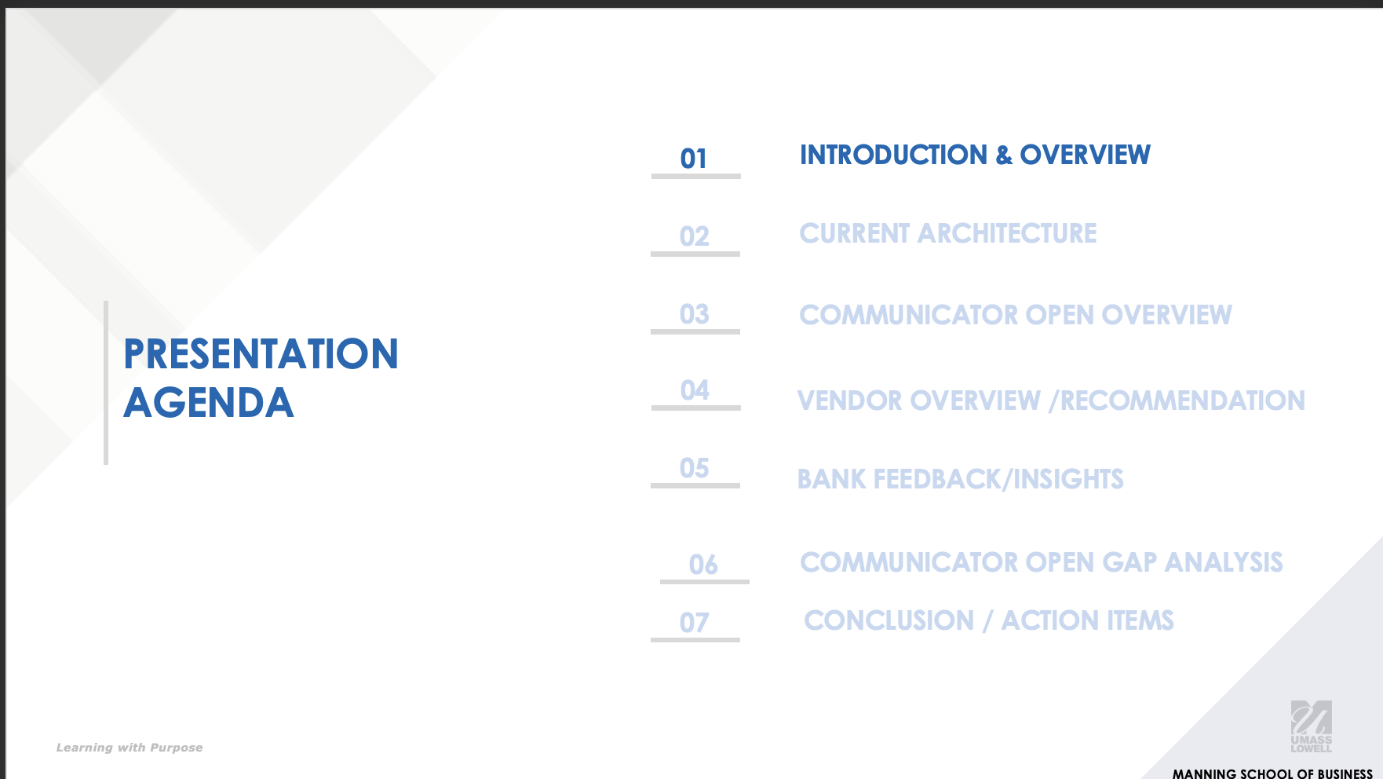
Gap Analysis
Agenda:
Presentation of gap analysis to EB team scheduled next week.
Objective is to compare their current data architecture, point out the value of communicator open, and give detailed overview of our conversations with the vendors and other banks.

Slide 11
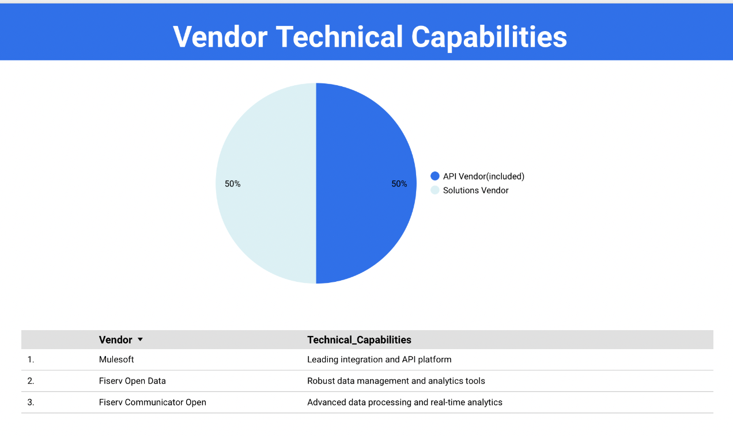
Descriptive Analytics Dashboard
Work in progress
Purpose:
Give the EB team an interactive dashboard that will showcase the work we have done.
It will allow them to filter down vendor details for the following categories.
Cost
Functionality
Market Share
Security
Documentation & Support
Implementation Process

Slide 12

Milestones & Deliverables
Milestone 1: Determine project scope and goals.
Milestone 2: Present insights from bank interviews.
Milestone 3: Present gap analysis to Enterprise Bank.
Milestone 4: Descriptive Analytics Dashboard
Milestone 5: Present vendor insights, generate RFP, and prepare final project presentation.

